Slide 1
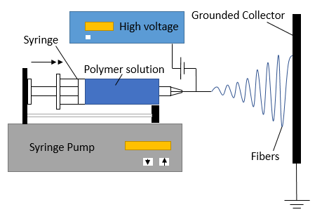
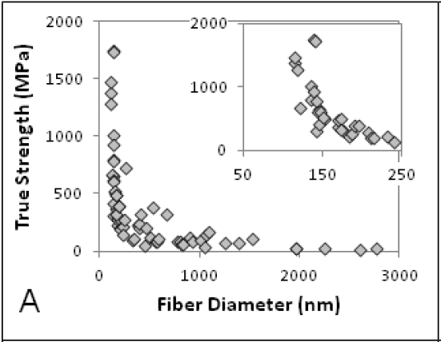
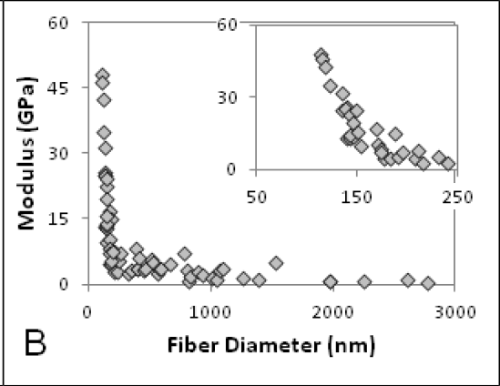
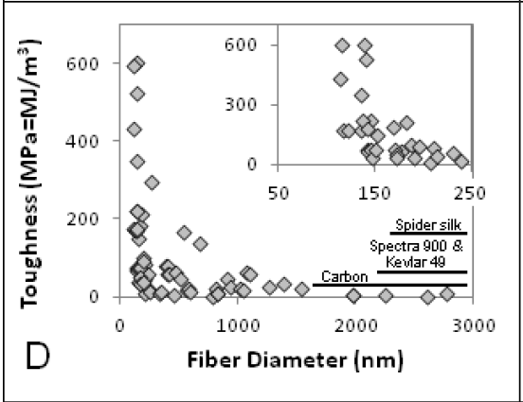
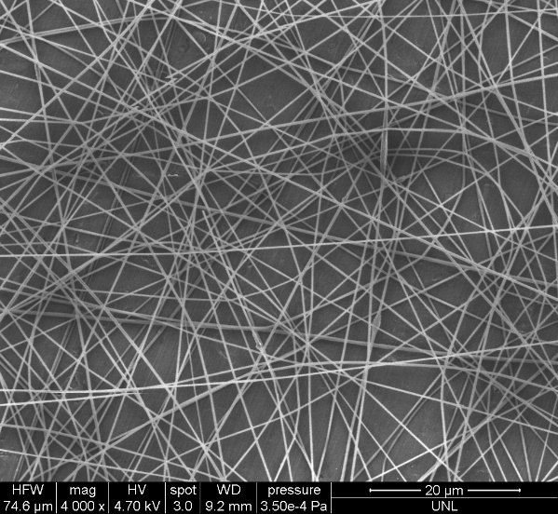
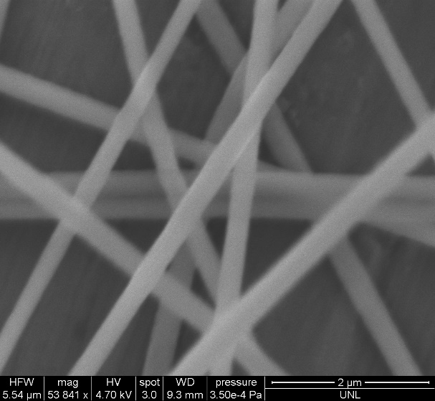
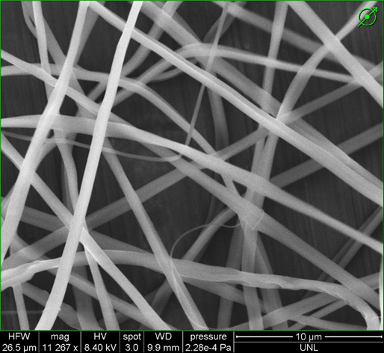
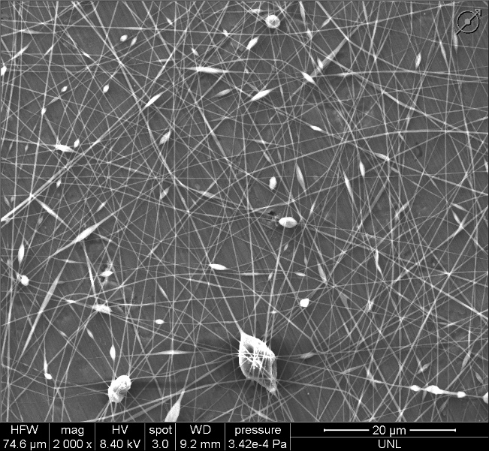
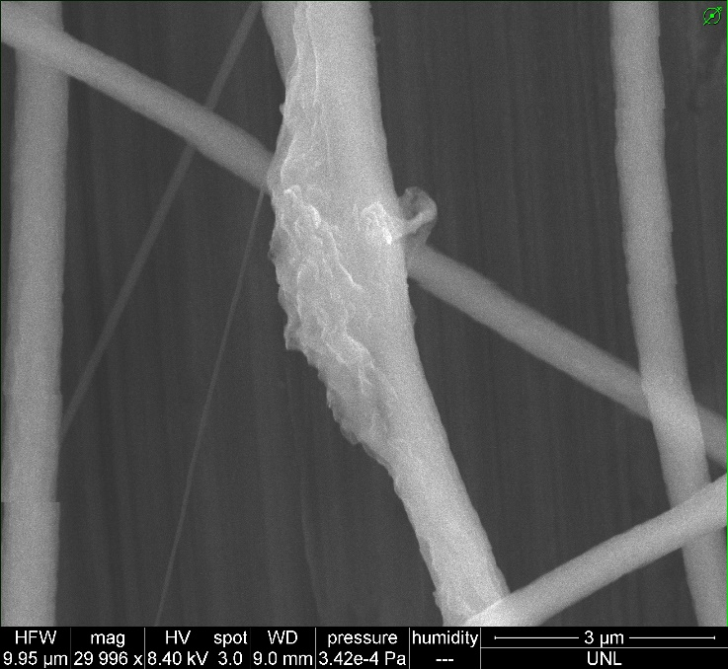
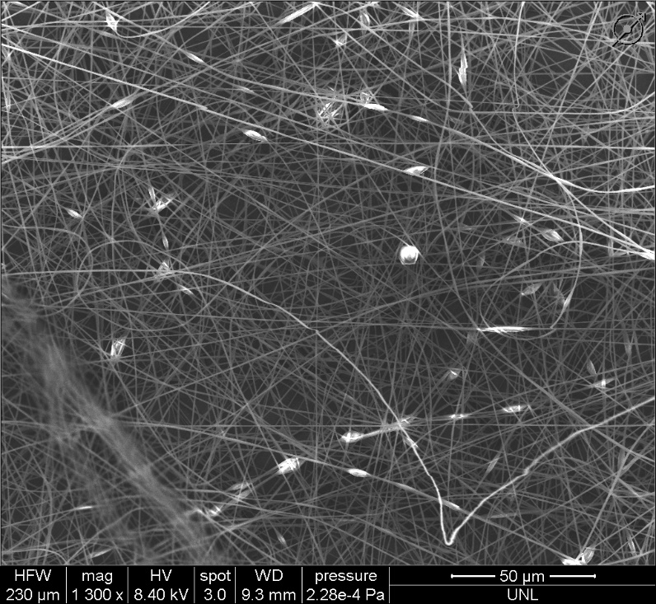
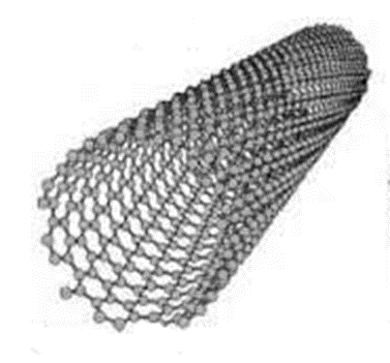
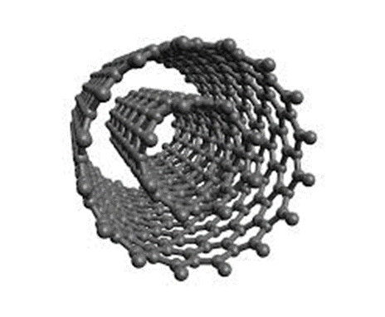
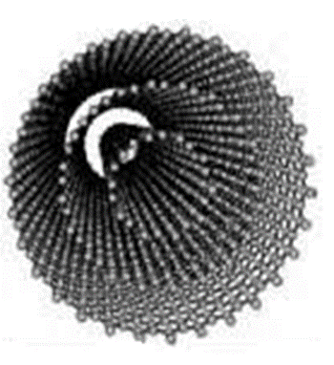
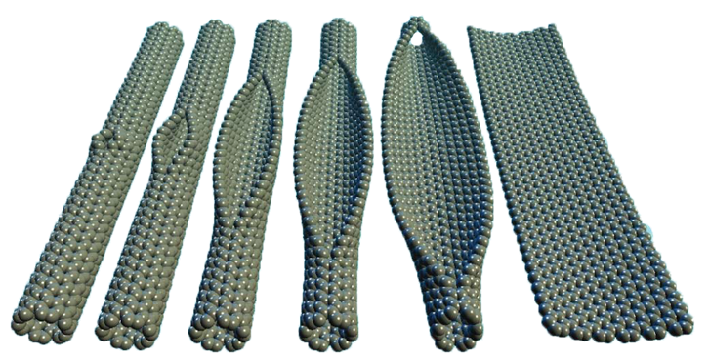
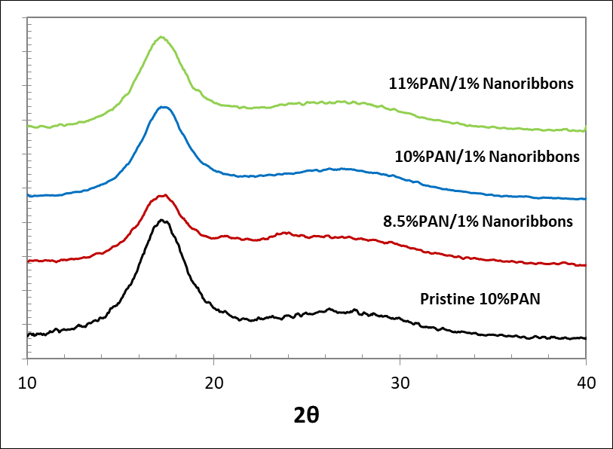
Incorporation of Graphene Nanoribbons into Continuous Electrospun Nanofibers
John Woollam Foundation
PLACE YOUR TITLE HERE
UCARE
**Poster Author(s) Go Here
Iakov Golman (John Woollam Scholar) ¹, Dimitry Papkov ¹, Taylor Stockdale ¹, Gang Li ², Alexander Sinitskii ², Yuris Dzenis(PI) ¹ ¹ Department of Mechanical and Materials Engineering, University of Nebraska-Lincoln, ²Department of Chemistry, University of Nebraska-Lincoln
Introduction
Continuous carbon nanofibers (CNFs) present an attractive building block for a variety of multifunctional materials and devices. CNFs are produced by carbonizing electrospun nanofibers from polymer-based precursors, such as poly(acrylonitrile) (PAN). However, the carbonization of PAN precursors results in CNFs with poor graphitic structure.
One way to improve the graphitic structure is to increase the carbonization temperature. However, this method is very expensive due to increased energy consumption. Another, more cost-effective approach is to use oriented nano-inclusions to increase the alignment of the polymer chains inside the precursor fiber. Such inclusions include carbon nanotubes (CNT), cellulose nanocrystals (CNC), and graphene oxide (GO). Recently, graphene nanoribbons (GNR) have emerged as a promising nanoparticle that can be used for templating CNFs with improved graphitic structure, as well as increased mechanical and transport properties.
The main objective of this project was to demonstrate the manufacturability of uniform continuous nanofibers with graphene nanoribbons. Effects of GNR on nanofiber morphology and polymer crystallinity are analyzed and compared to other prospective 1D nanoinclusions.
Electrospinning Continuous Nanofibers
Conclusions
Manufacturability of uniform, continuous NFs with GNR nanoribbons is successfully demonstrated
Absence of bulges/beading in NFs with GNRs compared to other nano-inclusions is highly promising for high mechanical properties of CNFs
XRD results indicate GNRs are present and interact strongly with the precursor polymer
Background
Electrospinning Set Up
Fine Diameter Control of Electrospun Nanofiber
Demonstrated Size Effects in Mechanical Properties
Discussion
Optimization of the spinning parameters and fine diameter control of nanofibers will be conducted
Effects of GNR on polymer structure and orientation are in progress using Raman spectroscopy
Effects on graphitic structure will be studied through carbonization of PAN/GNR NFs by using Transmission Electron Microscopy and Selected Area Electron Diffraction
Manufacturability and Effect on Polymer Morphology/Structure
20µm
2µm
30µm
10µm
8.5% PAN + 1% GNR
8.5% PAN + 1% DWNT
Acknowledgements
This research was supported in part with funds from the John Woollam Foundation, Office of Naval Research (ONR), National Science Foundation (NSF), UNL UCARE, and NCESR.
20µm
3µm
50µm
10µm
References
SWCNT
DWCNT
MWCNT
8.5% PAN + 1% MWNT
8.5% PAN + 1% CNC
1.Papkov D, Beese AM, Y, Goponenko A, et al. (2013) Extraordinary Improvement of the Graphitic Structure of Continuous Carbon Nanofibers Templated with Double Wall Carbon Nanotubes, ACS Nano 2013 7 (1), 126-142 2.Papkov D, Zou Y, Goponenko A, et al. (2013) Improved Graphitic Structure of Continuous Carbon Nanofibers via Graphene Oxide Templating. Advanced Functional Materials 23 (46), 5763-5770 3.Kosynkin D, Higginbotham A, Sinitskii A, et al. (2009) Longitudinal unzipping of carbon nanotubes to form graphene nanoribbons. Nature 458,872-876.
4. Sinitskii A, Kosynkin D, Dimiev A, et al. (2010) Graphene Nanoribbon Devices Produced by Oxidative Unzipping of Carbon Nanotubes. ACS Nano 2010 4 (9), 5405-5413
Graphene Nanoribbons
XRD Results: Effects of PAN Concentration with 1% GNR
XRD Results: Comparison of GNR
with Other 1D Nano-inclusions
XRD Crystallinity Summary

